Slide 1


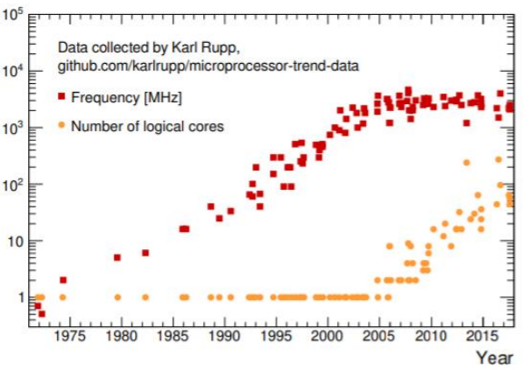
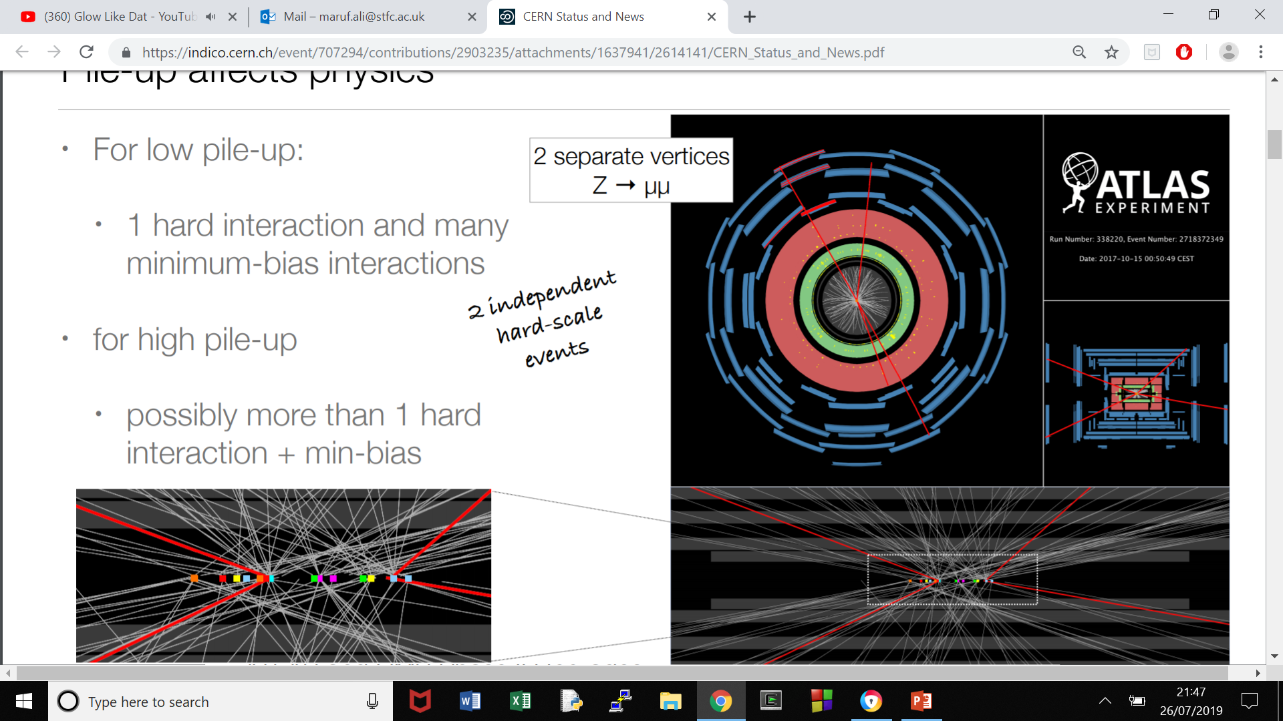
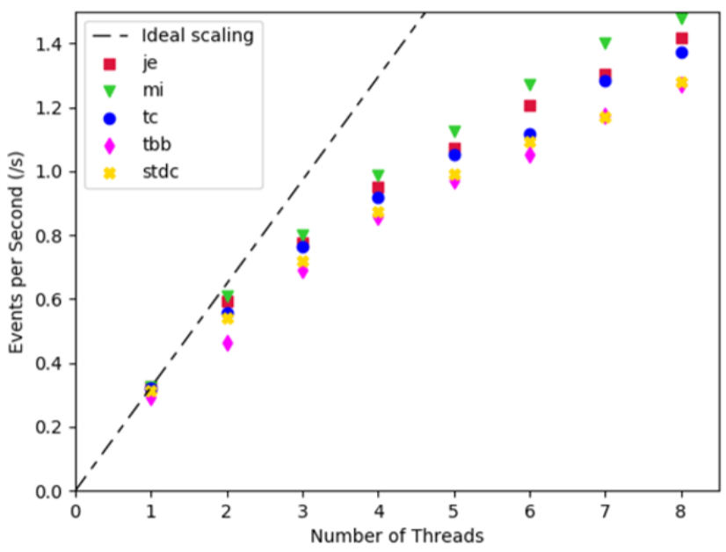
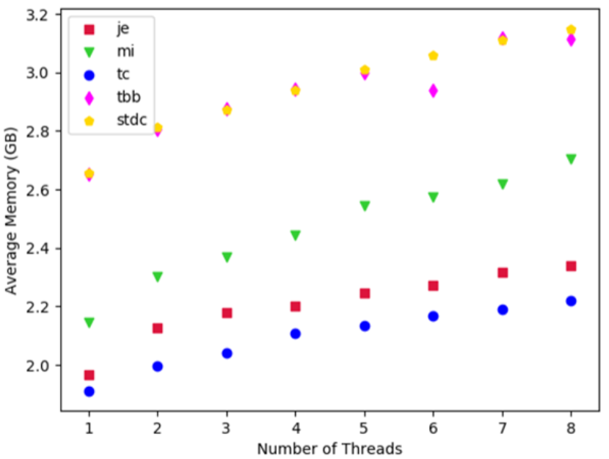



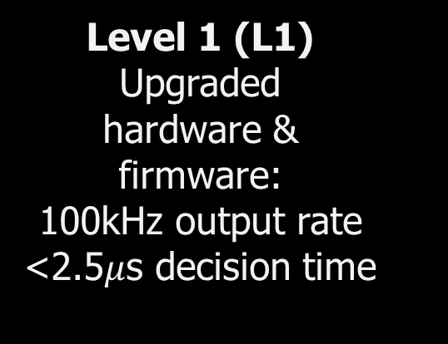
Optimisation of the High- Level Trigger (HLT) Maruf Ali (STFC RAL)
Large Hadron Collider:
The LHC creates collisions of particles (known as events).
ATLAS (A Toroidal Lhc ApparatuS) is one of the 4 main experiments. I worked as part of STFC in collaboration on the ATLAS experiment via software development.
The detector can be divided into several main components where we have the Trigger System, subdivided into 2 levels.
The ATLAS code allocates and deallocates very large blocks of memory so as a result, using different memory allocators instead of the standard glibc can possibly offer significant performance improvements to the detector without modifying the contents of the actual code. Single-Threaded Network (processes occur one after the other) to a Multi-Threaded Network (events are processed in parallel) to increase efficiency for the same number of CPU cores where threads describe the way programs divide themselves into 2 or more simultaneously running tasks. We are working with single threads so therefore redesigning the core framework for native, efficient & user-friendly MT support offers a robust solution. Currently in Long Shutdown 2 or LS2 (2019-20), where I ran offline reconstruction software to obtain results for different ‘settings’ – these refer to the same output for a different memory allocator.
Project Motivation:
Each proton-proton collision (event) records as 1 mb, 40 million collisions/s giving 40 Tb/s of output. CPU have been getting more expensive with declining processing power – purchasing more will be less incentivising.
Question: How can we store all this data while sustaining vacant disk space?
Solution: Trigger System – L1 (hardware) & HLT (hardware + software) where events are filtered for more interesting physics with reduced data output rate (~1 Gb/s)
Pile-up:
An abundance of particle collisions from the initial interaction point caused by the proton-proton collisions. High level trigger filters rare from common events
Common tracks - White
Rare tracks - Red
Figure 1: Scatter plot of number (log-scaled) vs. year no.
Run 2 (2015-18):
Level 1 (L1)
Upgraded
hardware &
firmware:
100kHz output rate
<2.5$μ$s decision time
High-Level Trigger
(HLT)
Custom & offline reconstruction software:
1kHz output rate
~200ms dec. time
Experiment:
I am currently investigating the relative performance of 5 allocators (jemalloc, mimalloc, tcmalloc, tbbmalloc & stdcmalloc) on ATLAS HLT code.
There are 2 important parameters in measuring the performance of a memory allocator. The first is it’s level of throughput which is equal to the number of events per second. The second is the memory usage given the measure of RSS or the resident set size represents the amount of RAM dedicated towards allocating memory for a process.
I measured these 2 parameters a function of the number of threads to get closer to conclusive results.
Where this structure will be maintained for Run 3 with a newly implemented Multi Threaded network.
As the trigger process progresses, each consecutive level will have a greater decision time to prioritise the most important events (applies to both runs)
Results:
Conclusion:
In summary, I have preloaded libraries for 5 different types of memory allocators to see if we could increase the efficiency without modifying the Athena code.
Both ‘mimalloc’ and ‘jemalloc’ perform better than the current default ‘tcmalloc’ to a certain extent. This is dependent upon the balance and demand between throughput and memory usage which varies according to different processes within the detector.
For example, the HLT is not memory limited, this would favour mimalloc as opposed to the simulation which relies more upon memory and therefore would favour jemalloc. Subject to further research for a complete conclusion.
Figure 2 : Plot of the throughput (/s) as a function of the number of threads.
Figure 3 : Plot of memory usage (GB) as a function of the number of threads.
September 2019
Acknowledgements: Thanks to my supervisor Dr Stewart Martin-Haugh and to EEO Kay Pearson for assisting me with securing an internship.
October 2019

